Slide 1




European Symposium MR 2.0
Video-conferencing in cross-border criminal proceedings. Advantages and drawbacks
Mar Jimeno Bulnes
Professor of Procedural Law
University of Burgos

Slide 2
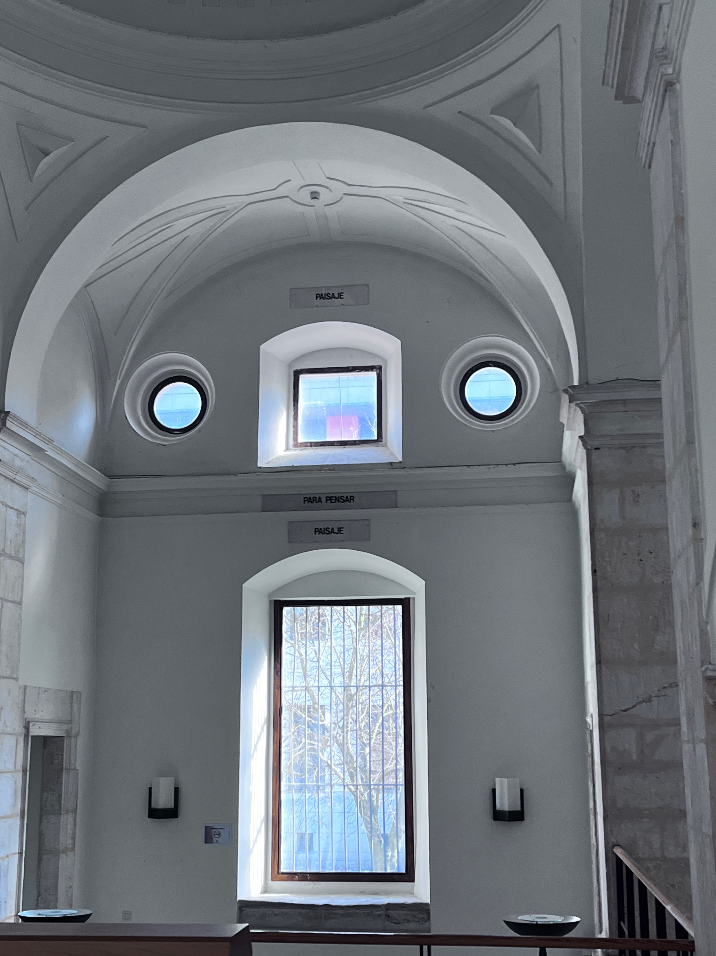
SUMMARY
Preliminaries
Statu quo:
  European Union
  Member States
MR 2.0 research:
  Annotated index
  Country reports
  Overarching analysis
  Recommendations
Advantages and drawbacks
Concluding remarks

Slide 3

PRELIMINARIES
Before and after in the use of videoconferencing since the covid pandemic, both in judicial cooperation and in domestic proceedings
The sanitary crisis has led to the widespread use of videoconferencing in criminal proceedings, albeit with greater limits or precautions in criminal proceedings
Subsequent contribution to the objective of effectiveness and efficiency of justice in favour of the use of videoconferencing to replace face-to-face proceedings, e.g. Spain:
    Royal Decree-Law 6/2023 of 19 December, approving urgent measures for the implementation of the Recovery, Transformation and Resilience Plan in the areas of public service of justice, civil service, local government and patronage: ensures that “judicial immediacy is preserved in all proceedings by means of videoconferencing” (Preamble) with provision for secure identification systems and procedural requirements
    Organic Law 1/2025 of 2 January on measures for the efficiency of the Public Justice Service: even abolishes the previous limit for holding a trial in the absence of the accused, until now set at 2 years' imprisonment or 6 if it was a different type of sentence (prior Art. 786 (1) Criminal Procedure Act

Slide 4
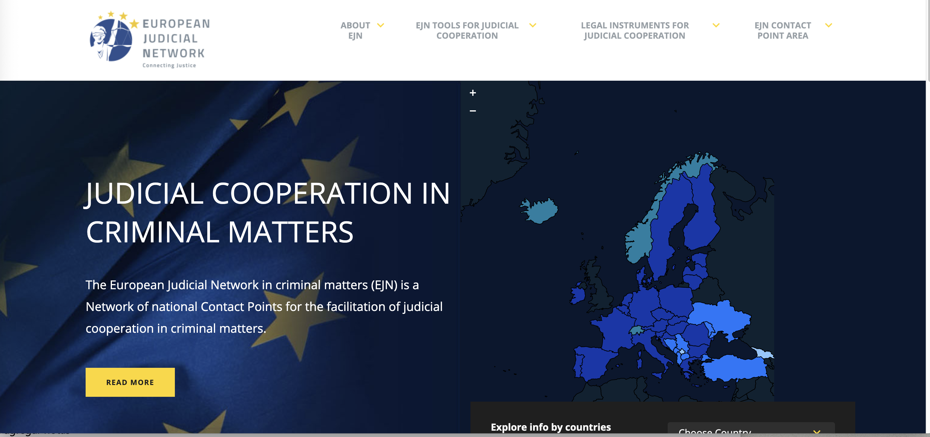
European Union (I)
Convention on mutual assistance in criminal matters between the member states of the European union (MLA, 29 May 2000)
https://www.ejn-crimjust.europa.eu/ejn/libcategories.aspx?Id=32
Not in force in all MM.SS. E.g. Croatia and Greece
Origin in European Convention on Mutual Assistance in Criminal Matters of the Council of Europe (Strasbourg, 20.IV.1959) but no rules on videoconferencing
First regulation of videoconferencing in Art. 10 MLA 2000: hearing by videoconference with differences
  General rule: hearing of witness/expert (no need of regulation in MM.SS.)
  Stricter rule: “hearing of accused person” according to national law and with his/her consent

Slide 5

European Union (II)
Directive 2014/41/eu of the European parliament and of the council of 3 April 2014 regarding the European investigation order in criminal matters (EIO): part i
https://www.ejn-crimjust.europa.eu/ejn/libcategories/EN/120/-1/-1/-1
Art. 24: hearing by videoconference or other audiovisual transmission
  Hearing of witnesses, experts and accused person/s
  Stricter regulation for hearing of accused persons:
    Requirement of his/her consent
    Observance of fundamental ”principles” of the executing MS
  General rules such as:
    Presence of the executing judicial authority
    Assistance of interpreter when necessary
    Information and observance of procedural rights e.g. Non incrimination

Slide 6

European Union (III)
Directive 2014/41/eu of the European parliament and of the council of 3 April 2014 regarding the European investigation order in criminal matters (EIO): part II
https://www.eurojust.europa.eu/ar2020/4-enhancing-judicial-cooperation-policy-and-instruments/422-depth-analysis-first-years#
Preamble
  Recital 25: Implementation of EIO for “all stages of criminal proceedings, including the trial phase, of an investigative measure”
  Recital 26: Issuance of EIO for the purpose of hearing of the suspect or accused person by videoconference as an alternative measure to EAW issuance under the principle of proportionality
Eurojust EIO report 2017-2019 (Nov. 2020):
    Mostly of MM.SS. recognise and execute EIOs for the hearing of a suspected or accused person by videoconference in any procedural phase (investigation, trial and/or appeal); only 2 MM.SS. does not during trial or appeal stage
    Need of consent by suspect or accused person: only one Member State can the judicial authority order the hearing by videoconference ex officio
    All MM.SS. recognise and execute an EIO for the hearing of witnesses by videoconference in the trial phase
  Eurocoord Code of Best Practices (March 2019): Best Practice n. 62 proposed explicitly: “The preferred way to carry out the witness interrogations is to request to do it via video-conference. This should be the preferred way in all cases.”

Slide 7

Member States
SPAIN AS CASE STUDY
https://www.ejn-crimjust.europa.eu/ejn2021/ContentDetail/EN/5/29
Cross-border criminal proceedings: Act 23/2014, of 20 November, on mutual recognition of judicial decisions in criminal matters in the European Union (LRM)
  General rule on Art. 22: provision on the exercise of the defendant's right to be heard by means of a hearing by telephone or videoconferencing
  EIO implementation:
    Art. 197: Issuing an EIO for a hearing by video conference of suspects, witnesses or experts
    Art. 216 Executing an EIO for a hearing by video conference providing requirements and proceedings (stricter regulation for hearing of suspects than witnesses and experts)
  National criminal proceedings: Criminal Procedure Act 1882 (LECrim) provides videoconferencing for:
    The assistance of interpreter: Arts. 123 (5)
    Intervention of prosecutor at pre-trial stage: Art. 306
    Hearing of suspect (especiall y minors) or accused person, witness or expert when “physical appearance is particularly oneous or prejudicial” at pre-trial and oral stage : Arts. 325 and 731 (a)
    Assistance of lawyer to detainees and prisoners due to geographical distance no physical presence is possible in inmediate delay: Art. 520 (2) (c)

Slide 8

MR 2.0 research
Annotated index for the country reports
https://mutualrecognitionnextlevel.eu/
Possibility of using videoconferencing as an alternative to the physical presence of the defendant in issuing MS as a less intrusive measure
Possibility of using the EIO for the interrogation of suspect or accused person by videoconference instead of surrender (EAW)
Possibility of using the EIO not only in the pre-trial phase but also in the trial phase; if it is not possible to use EIO for the trial phase, it is still possible to use video conferencing
Possibility of videoconferencing with the sole purpose of ensuring the presence of the accused at the trial (i.e. without the purpose of gathering evidence)
The use of videoconferencing also in the dialogue between national judicial authorities when deciding on the application of a specific mutual recognition instrument

Slide 9
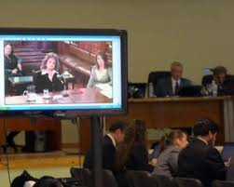
COUNTRY REPORTS: SPAIN
Very rarely use of videoconferencing for hearing of the defendant (p. 71)
Physical presence of the accused at trial except in exceptional circumstances (prior Art. 786 (1) LECrim)
EIO for the purpose of videoconferencing at the trial phase just for witnesses and experts (p. 71)
Need of consent by defendant and defence (p. 74)
Need of control of observance of legal requirements (p. 74)
Mention to case-law:
  Spanish Supreme Court 17 March 2015: the creation of a European judicial area has made videoconferencing a regulated mean of widespread application (p. 96)
  CJEU 4 July 2024, Procès par visioconfèrence, C-760/22: possibility for accused person to participate in the hearings of the trial by videoconferencing at his or her express request “provided that the right to a fair trial is guaranteed” (p. 97)
Videoconferencing also for communication between issuing and executing judicial authorities
By contrast, videoconferencing is not used for summons inasmuch a formal document of notification is required (p. 126)

Slide 10

COUNTRY REPORTS: GERMANY
“The public prosecutor may issue an EIO in order to examine the accused person via videoconference” (p. 33)
“Art. 24(1) DR 2014/41/EU expressly covers the interrogation of the accused person, irrespective of the stage of proceedings. Therefore, a videoconference for this purpose in the trial phase will be possible” (p. 36)
German government allows videoconference “for the sole purpose of ensuring the participation of the accused person in the trial, if the law of the other MS allows for a criminal trial in via videoconference and the accused person has given his consent” (p. 36)
“Even without issuing an EIO a videoconference (is possible) to ensure the presence of the accused at the trial can be granted and executed under the general rules on mutual legal assistance according to EU law” (p. 36)
“Videoconferences are less costly because the technical equipment is available for the judicial authorities” (p. 43)
“As a matter of principle, this cooperation instrument is available and used for the interrogation of suspects and accused persons” (p. 52) but German law does not allow the courts to request for a hearing by videoconference for the purpose of enabling the accused person to participate in the trial because the presence of the accused person is mandatory (section 230 CCP; see the exception under section 232(1) CCP); videoconference during the trial is limited to witnesses and experts” (p. 69)

Slide 11

COUNTRY REPORTS: POLAND
“No doubt DR 2014/41 allows for issuing the EIO for the purpose of hearing a suspect (Article 10 (2) (c)), also by use of videoconference (Article 24) but the latter option depends on the consent of a suspect” (p. 30)
“In particular, a suspect detained in the issuing state may participate in the investigative activities conducted with the use of videoconference (hearing of witnesses, experts, etc...) in the executing MS” (p. 31)
“With reference to the question whether a videoconference is possible for the purpose of ensuring participation of a defendant in the hearing and without issuing the EIO, the answer seems to be affirmative” (p. 38)
“The CCP does not regulate the opportunity to interrogate a suspect by videoconferencing in the course of investigations, providing only for such option at the trial stage of the proceedings” and only in specific circumstances (presence is mandatory and he/she is deprived of liberty) according to Art. 374 (4-8) and 377 (4) CPP (pp. 53 and 74)
“All interviewed practitioners stated that they do not have any experience in issuing the EIO the purpose of interrogation of a suspect via videoconference in the course of investigations since it is not allowed by the Polish law. At the same time, they all argue that such an opportunity should be introduced to the CCP and once provided would be used by them as very useful measure” (p. 54)
“Summarizing, the Polish law provides for the opportunity to conduct the main hearing by means of videoconference and to secure “remote” participation of the accused in such hearing” (p. 91)

Slide 12

COUNTRY REPORTS: THE NETHERLANDS
Since the object of the EIO is to have ‘specific investigative measure(s) carried out in another Member State (‘the executing State’) to obtain evidence (…)’ (Article 1(1) of Directive 2014/41), the activity ‘hearing’ the suspected or accused person by videoconference would seem to denote hearing him as an investigative measure” (p. 43)
CJEU Linte, C-285/23, still pending, preliminary ruling promoted by Latvia after refusal of EIO by Germany as executing judicial authority because this participation by videoconferencing at the trial is not an investigative measure and there is not consent by the accused person; questions in relation to application of the EIO to the trial phase, equivalence of videoconferencing to physical presence and the possibility for direct communication between the judge a quo and the suspect/accused person
“According the EIO mutual evaluation report on the Netherlands, even though it is not possible to issue an EIO for the use of videoconference for the purpose of standing trial, it is possible to issue an EIO for the use of videoconference for the purpose of hearing the accused person at trial with the aim of gathering evidence” (p. 47)
“It is not possible to interrogate a suspect via videoconference who is present in another Member State without an EIO (unless that other Member State is Denmark or Ireland)” (p. 56).
“The Code of Criminal Procedure allows for videoconferencing in order for the defendant to participate in the trial, but, … only if he consents to it (Article 131(a)” (p. 79)

Slide 13
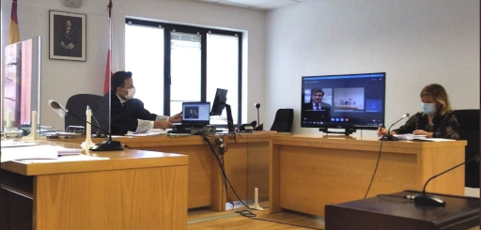
OVERARCHING ANALYSIS: EIO
  EU Law does not provide legal basis at the moment in order to use videoconference in trial stage (p. 16)
  Also, no legal requirements concerning security in the use of videoconferencing (Spanish Memorandum and Good practices, Block IV) (p. 16)
  “Conducting a trial via videoconference would probably be more efficient than conducting an in absentia trial” (p. 17)
  Possibility to use EIO for interrogating the accused person at the trial as “investigative measure aimed at evidence gathering”; scepticism by the Netherlands on the basis of Recital 25 DEIO (p. 19)
  “Dominant opinion is that Directive 2014/41/EU does not provide a (clear) legal basis for videoconferencing in order to ensure the presence of the accused; problems on the perspectives of effectiveness, efficiency and proportionality” in order to avoid “in absentia ground for refusal… and would be a les intrusive alternative tan surrender” (p. 23)

Slide 14

OVERARCHING ANALYSIS: DIGITALISATION (I)
  Section 7.10.1: Digitalisation of judicial cooperation
  2 new EU instruments in both, civil and criminal matters, including also videoconferencing:
    Regulation (EU) 2023/2844 of 13 December 2023
    Directive (EU) 2023/2843 of 13 December 2023
  Promotion in general of the use of electronic communication from both perspectives:
    Between competent judicial authorities
    In the judicial cooperation procedures
  Specific conditions in the case of suspect/accused
    Justification on particular circumstances of the case
    Consent by the suspect and/or accused persons
  Transposition still pending in MM.SS.
“The digitalisation of judicial cooperation in criminal matters pursued by the regulation and the directive, as such, has some impact on the effective, efficient and coherent application of the instruments” (p. 136)

Slide 15
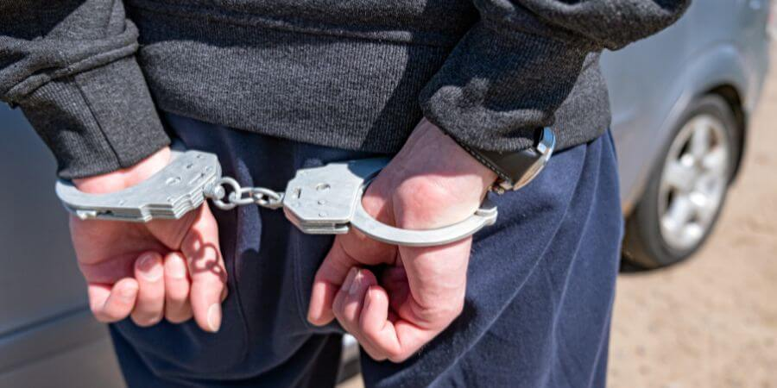
OVERARCHING ANALYSIS: DIGITALISATION (II)
Section 7.10.2: EAW, videoconferencing and effective and coherent application
“The possibility of requesting a hearing on the basis of Article 18(1)(a) of FD 2002/584/JHA is seldom used in practice… A hearing by videoconference allows the issuing judicial authority to conduct the hearing and to interact with the requested person directly instead of relying on a hearing conducted by the executing judicial authority. Perhaps the possibility of hearing the requested person by videoconference will resuscitate Article 18(1)(a) of FD 2002/584/JHA” (p. 137)
“A hearing of the requested person by videoconference would give him the opportunity to point those circumstances out to the issuing judicial authority and to request withdrawing the EAW and, when applicable, replacing it with another instrument” (p.137)
“In short, the aforementioned developments in the EU legal framework on digitalisation of cooperation might facilitate improving the coherence (especially the proportionality), effectiveness and efficiency of the application of the cooperation instruments” p. 140)

Slide 16
RECOMMENDATIONS
EIO for ensuring the presence and interrogation of the accused person at the trial by videoconference
  To the EU legislator: provide a clear legal basis: Art. 24 DEIO is not enough
  To the national legislators MM.SS.: introduce if it is the case legal basis in order to request participation of accused person in trial via videoconference
  Hearing the requested person by videoconference according to Art. 18 (1) (a) DM EAW
  To the issuing judicial authorities MM.SS.: use and practice of Article 18(1)(a) of the EAW Framework Decision, once the requested person is arrested in the executing Member State” (p. 19)
Videoconferencing as an alternative to temporary surrender in postponed surrender cases (Art. 24 DEIO only provides temporary surrender in such case)
  To the EU legislator: amend Art. 24 DEIO in order to provide for interrogation via videoconferencing in this case
Improvement of videoconferencing security
  To national legislators in MM.SS.: “The States must guarantee the security of these systems by offering robust, encrypted infrastructures and dedicated communication lines, protecting judicial communications from external interferences and ensuring confidentiality” (p. 20)
  To legal professionals involved in judicial cooperation matters: “To improve the security of videoconferencing, ensure the presence of a court authority or a legal professional at the location where the person being interrogated is located” (p. 20)
Caution on the use of videoconferencing in judicial cooperation
To the issuing authorities of all MM.SS: “Digitalisation in judicial cooperation should be applied cautiously, ensuring it respects procedural guarantees, and the rights of individuals involved” (p. 24)

Slide 17
ADVANTAGES AND DRAWBACKS
ADVANTAGES
DRAWBACKS
Videoconferencing makes possible the “effective, coherent, integrative and proportionate application of judicial cooperation instruments in criminal matters” (Mutual Recognition 2.0 title)
Videoconferencing reduces time and costs of criminal proceedings
Videoconferencing facilitates international, EU and even national judicial cooperation
Videoconferencing avoids trials in absentia; it is obviously better that no presence in trial
Videoconferencing as alternative to the application of mutual recognition instruments that are more restrictive of individual freedoms e.g. EAW
Concerns on technical infrastructure in MM.SS. to make possible videoconferencing with success
Concerns on security issues e.g. authenticity by institutional channels, confidentiality…
Concerns on the observance of procedural rights e.g. presence of lawyer, interpreter, judicial authorities (judge, prosecutor and clerk of the court)
Concerns on the possibility of intimidation or coercion on declaration by the person (suspect/accused, witness, expert…)
Concerns on the reliability, even more convincing from physical presence (gestural language, etc.).

Slide 18

CONCLUDING REMARKS
KLIP, A. ”Editorial: the right to be present online”, EJCCLCJ 32 (2024) 1-14
  How can the defendant participate online?
  Does online presence have to be equal to physical presence?
  What conditions ought to be in place to realise this?
  Can the defendant be obliged to be present online?
  Do the authorities have to offer online presence?
  Is there a right to be present online?
Conclusion:
  “Nostalgia of the trial in the courtroom” (p.14)
  Formality of the trial to my point of view cannot be substituted by videoconferencing but this is the “course of time” in century XXI

Slide 19
Questions?
Thanks for attention
Mjimeno@ubu.es

